Slide 1

Neuroimaging – Dementia early diagnosis
S.K.Varshaa

Slide 2
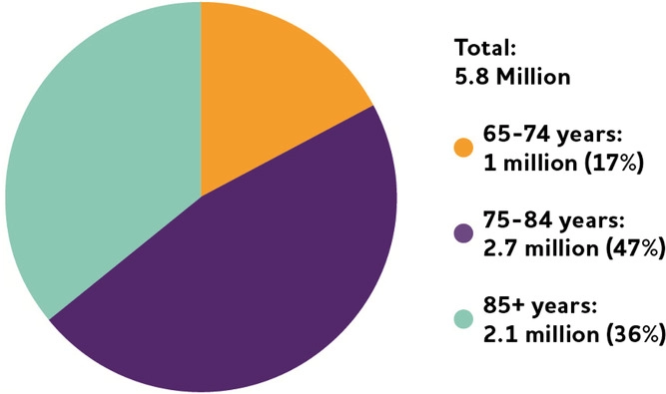
About - Dementia
Dementia is a neurocognitive mental disorder that is a general term covering several diseases causing dependency and disability among older adults worldwide . According to the World Health Organization (WHO), approximately 47 million people are living with dementia worldwide, and this number is expected to increase to 82 million in 2030 and 150 million by 2050

Slide 3
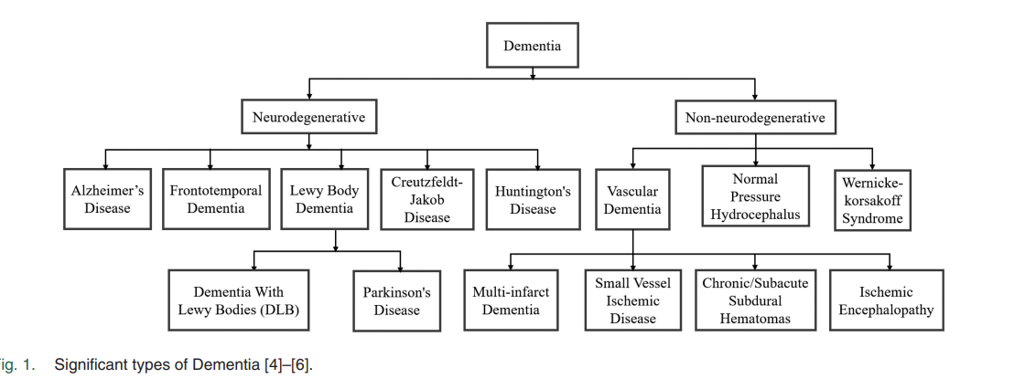
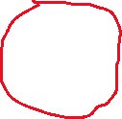
Dementia Classification

Slide 4
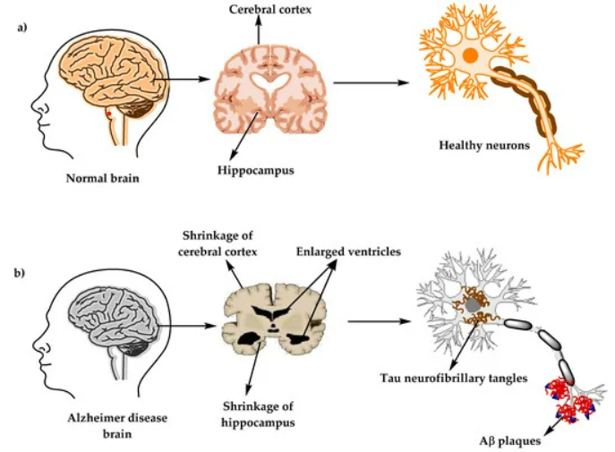
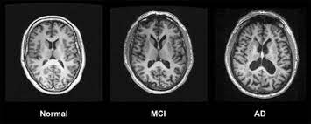


Alzheimer’s disease
Common stages of dementia that requires extensive medical care.
Early and precise analysis of AD prediction is necessary .
Chronic, neurobiological brain disorder that steadily kills brain cells .
In the early stages of AD, doctors use neuroimaging and computer-aided diagnostic approaches to classify the disease ​.

Slide 5
Dementia with Alzheimer's
Contoso
Mild cognitive impairment
Mild dementia
Moderate dementia
Severe dementia

Slide 6
Types
Mild cognitive impairment:
Lack of memory.
When left untreated it leads to severe dementia.​
Mild dementia:
Daily life will be affected.
Changes in personality.
Difficulties in executing routine tasks.
severe dementia:
The symptoms may become severe.
Patients may lack the capacity to communicate, and full-time treatment may be required for the person.
moderate dementia:
The everyday lifestyle becomes much complex.
Symptoms are equivalent to mild yet elevated dementia.
Patients become paranoid or irritated for no reason.
Sleep disorders are likely to occur as well.

Slide 7
My system
Two types of scan used for diagnosis:
MRI(Magnetic Resonance Imaging) .
PET(Positron Emission Tomography).
In this proposed model we consider MRI for diagnosis over PET.
This model is to be integrated with Web Application.
So MRI dataset will be uploaded.
CNN(Convolution Neural Network) from Deep Learning is used for creating the model.
Model is to be created from scratch with fewer number of parameters.

Slide 8

existing proposals!

Slide 9
Proposals!
Lu et al. - proposed a novel multimodal deep neural network with a multistage technique to identify people with dementia. This method provides 82.4% accuracy in Mild Cognitive Impairment (MCI) prediction and those patients later exposed to Alzheimer’s disease in three years.
Gupta et al. - proposed a diagnosis method for the classification of AD using the ADNI and National Research Center for Dementia (NRCD) dataset by combined features from cortical, subcortical, and hippocampus region from MRI images for classification of AD vs Healthy Control (HC).
Ahmed et al. - proposed the ensemble CNN model for feature extractor and SoftMax classifier to diagnose AD diagnosis. This model prevents overfitting and achieves an accuracy of 90.05% by using the left and right hippocampus area in MRI images.

Slide 10
Proposals!
Basher et al. - came up with a method to localize the target regions from large MRI volume to automate the process. This was done based on the left and right hippocampi.
Nawaz et al. - presented a pretrained Alexnet model to classify the stages of AD to address the class imbalance model. The pretrained model is used as the feature extractor and classified using Support Vector Machine (SVM), K-nearest neighbour (KNN) and Random Forest (RF).
fzal et al. - address the class imbalance problem in detection of AD by data augmentation framework and achieves the classification in a single view and 3D view of OASIS dataset.

Slide 11
Literature summary:
People chose selected region like cortical, sub cortical and hippocampus from the neuroimage for their analysis.
Some researchers used Alexnet Model to classify the stages of AD.
Tissue Segmentation is used to extract the Grey Matter from the dataset.
Siamese Neural Network was used by researchers to investigate the discriminative capacity of whole-brain volumetric asymmetry.
Grey Wolf Optimization technique with a decision tree, KNN model to diagnose AD.
In some researches SVM was used for classification.

Slide 12
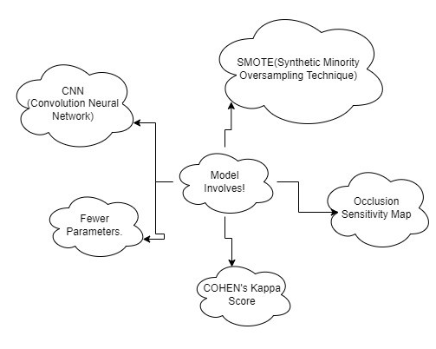
Main points to be addressed
CNN model with fewer parameters.
Parameter = ((shape of width of the filter * shape of height of the filter * no. of filters in the previous layer + 1) * no. of filters).
SMOTE technique to address Class Imbalance.
Occlusion Sensitivity Map to used to visualize image features.
COHEN’s Kappa Score to address the reliability of the model.

Slide 13
Flow of work!

Slide 14
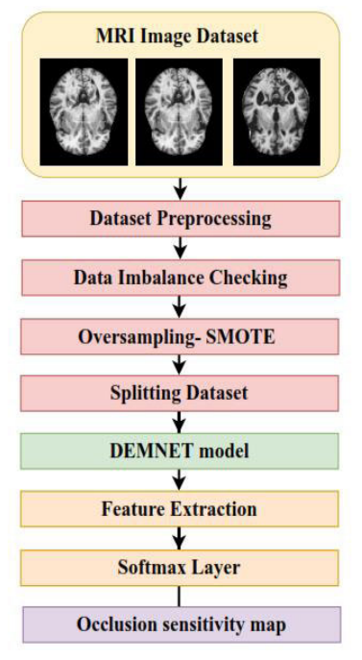
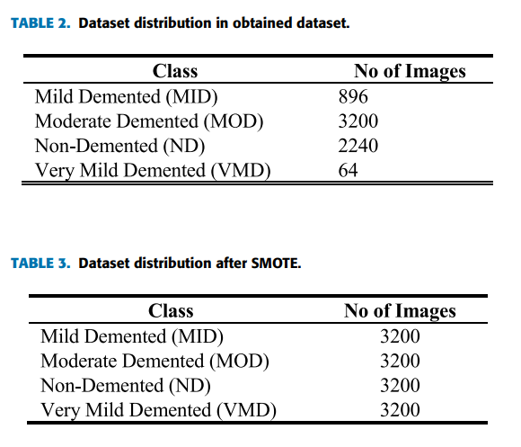
Flow of process and method used!
Main method used to handle class imbalance:
Synthetic Minority Oversampling Technique (SMOTE) technique.

Slide 15
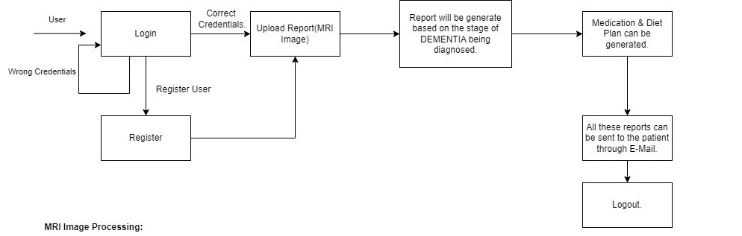
Way to present…
So this will generally be a web application .
On opening, the application asks for login credentials.
Upload the MRI image.
Medication suggestion and Diet suggestion will be generated.
Generated report can be sent through E-mail.

Slide 16
Reasons to choose
The reason to choose CNN is that, when compared to others this can automatically detect the important features without any human supervision.
Using SMOTE technique can handle the class imbalance.
In SMOTE we do not generate duplicates, but rather creating synthetic data points that are slightly different from the original data points.
To make this model reach users in an effective manner , this model is being integrated with Web Application.

Slide 17
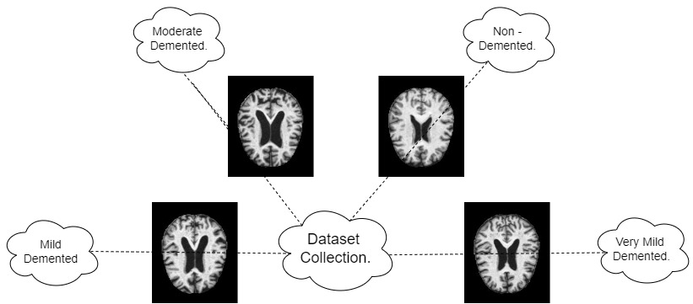
Collection of dataset

Slide 18
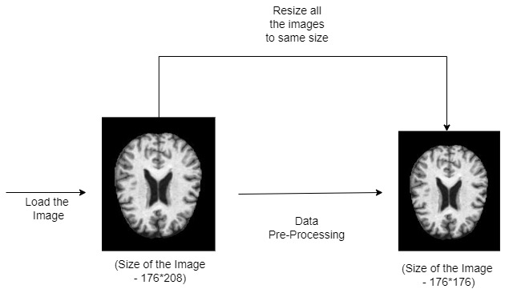
Dataset pre - processing

Slide 19
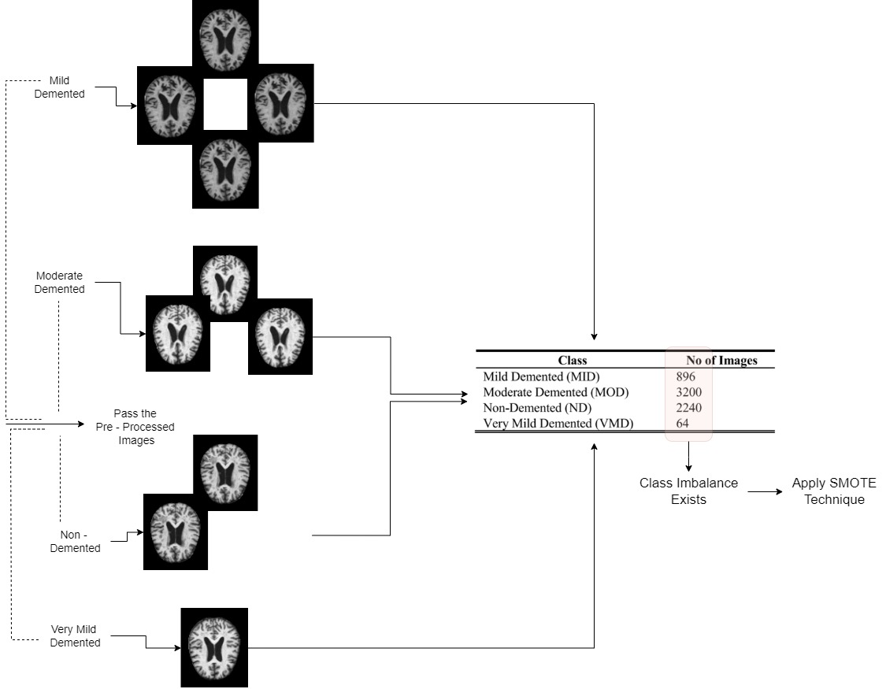
Dataset imbalance checking

Slide 20
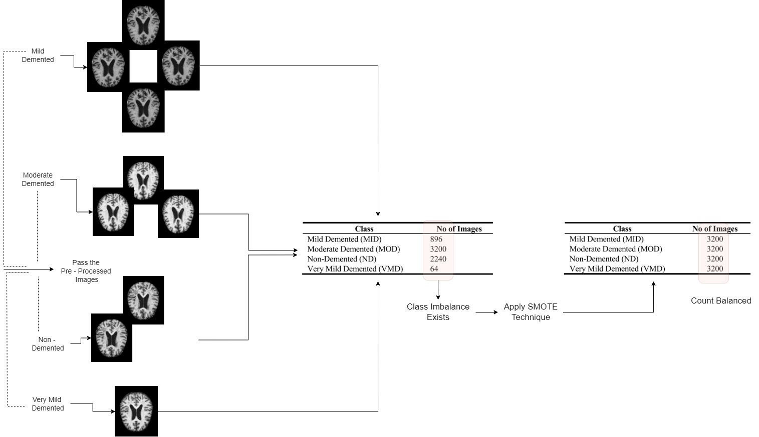

Slide 21
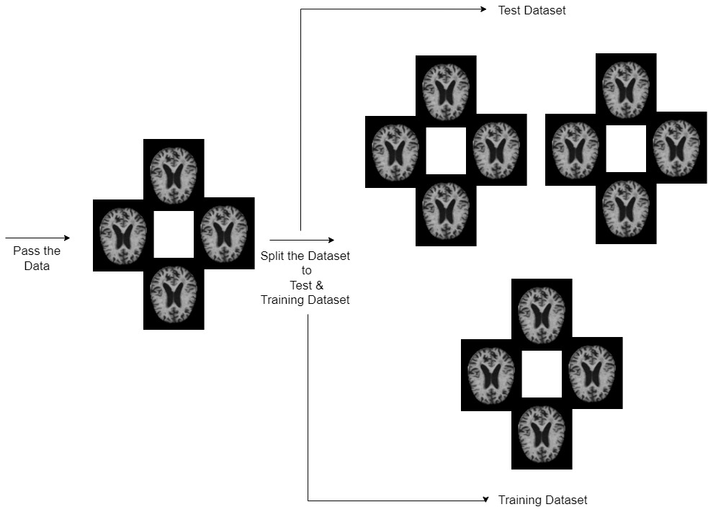
Spliting Dataset

Slide 22
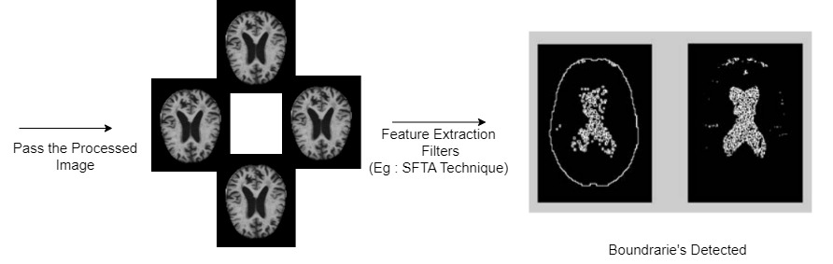
Feature extraction

Slide 23
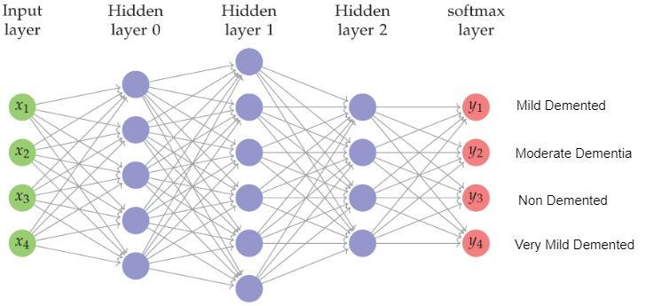
softmax

Slide 24





Tools and technologies
For creating model:
For web application:
Tensor Flow or Keras.
CNN.
Convolution Layer with ReLU.
MaxPooling.
DropOut Layer.
Fully Connected Layer.
Softmax.
Occlusion Sensitivity Map.
Python.
Flask.
React JS.
Additional features in web application:
Medication Suggestion.
Report Generation.
Diet Suggestion.
E-Mail.

